Slide 1



Tenants’ Housing Conference – 25 March 2025
Tenants’ Housing Conference

Slide 2
Tenants’ Housing Conference – 25 March 2025
Welcome and housekeeping
Matt Luik - Service Manager Quality, Assurance & Development

Slide 3
Tenants’ Housing Conference – 25 March 2025
Hello from Cllr Frampton
Cabinet Member for Housing

Slide 4
Tenants’ Housing Conference – 25 March 2025
Improvement plan. Inspection results, tenant satisfaction measures & transformation
Jamie Brenchley – Director, Housing

Slide 5

Acknowledging OUR Challenges as a Social Landlord
Understanding our obstacles and building tenant trust
Notes:
---
In this presentation, we will explore the challenges faced as a social landlord, our acknowledgment of failures, and the steps we are taking to improve. Transparency and accountability are essential in rebuilding trust with our tenants.

Slide 6

Apology
The regulator graded the authority’s housing service as a C3 with a judgement that "there are serious failings in the landlord delivering the outcomes of the consumer standards and significant improvement is needed.“
(November 2024)

Slide 7



Please download and install the Slido app on all computers you use
What words would you use to describe an outstanding social landlord?
ⓘ Start presenting to display the poll results on this slide.

Slide 8
Vision
"To be a leading social landlord, providing safe, high-quality homes and exceptional services that enhance the wellbeing and satisfaction of our residents.
We are committed to transparency, accountability, and continuous improvement, ensuring that every resident has a safe place to call home and feels valued and heard."

Slide 9
Please download and install the Slido app on all computers you use
What area of business do you think we need to prioritise?
ⓘ Start presenting to display the poll results on this slide.

Slide 10
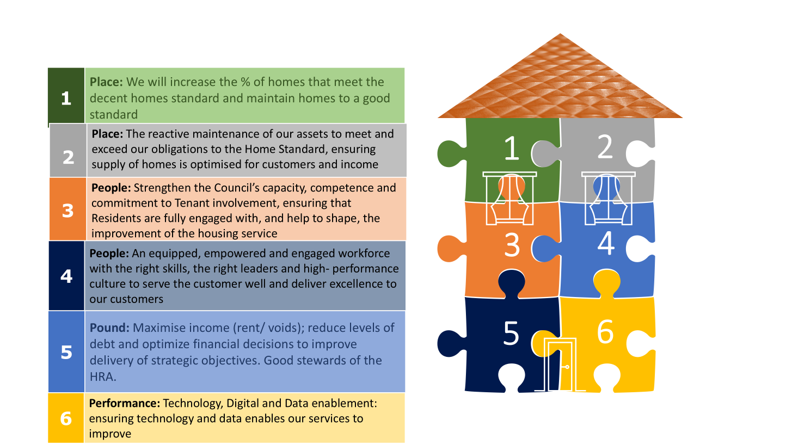
Keys to success

Slide 11
Please download and install the Slido app on all computers you use
What commitments do you want from us as a social landlord?
ⓘ Start presenting to display the poll results on this slide.

Slide 12
Commitment and accountability
1. Deliver good quality homes
Tenants can expect their homes to be of good quality, well maintained, well managed and safe.
2. Develop trusting relationships
The council will treat l tenants with respect in all our interactions. Relationships between tenants and SCC will be based on openness, honesty, and transparency. The council will build a trusting two-way relationship to create a fairer and more tenant focused housing service.
3. Deliver excellent customer services and experiences
The council will deal with and resolve tenant enquiries, keeping our promises. The council will strive to continuously improve services; being fair, inclusive and valuing diversity.
4. Provide support and tenancy sustainment
The council will provide support to tenants to improve the wellbeing and independence of our tenants - from providing information about domestic abuse, welfare rights, employment support, digital inclusion, to how to get an advocate to represent them.
5. Communicate effectively
Tenants will receive clear, accessible and timely information on the issues that concern them. Priorities. The council will be prepared to change our services to meet the specific needs of our tenants and take their feedback and suggestions for improvement seriously.
7. Enable a stronger tenant voice to influence the council
Views from tenants will be sought and valued and this information will be used to inform decisions and working practices. The council will strive to involve tenants in decision making about their homes and neighbourhoods, ensuring every individual tenant feels listened to on the issues that concern them and can speak without fear.
8. Be accountable
Collectively, tenants will work in partnership with SCC to independently scrutinise and hold them to account for the decisions that affect the quality of their homes and services.
9. Make it simple to tell us when things go wrong
Tenants will have simple and accessible routes for raising issues, making complaints, and seeking redress. Tenants will receive timely advice and support when things go wrong.

Slide 13
Tenants’ Housing Conference – 25 March 2025
Planned Maintenance, Decent Homes & Capital spending Landlord controlled heating
Ola Onabajo - Service Manager - Asset Management • Corporate Estate & Assets

Slide 14

Tenants at the Heart of Asset Management
Ola Onabajo – Service Manager, Asset Management

Slide 15

What is the Role of Asset Management
Responsible for all the Council’s land & buildings (assets).
Responsible for setting the strategic direction of planned investment
Setting the budgets for ensuring robust & sustainable investment in those assets.
Ensuring a proactive maintenance regime for those assets

Slide 16

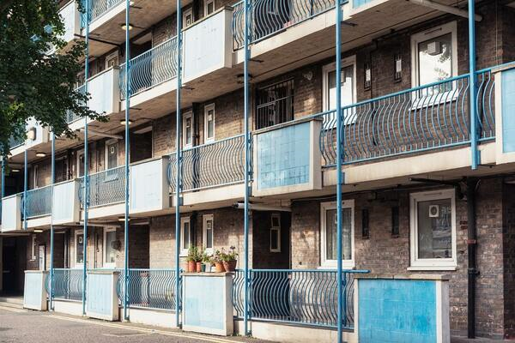
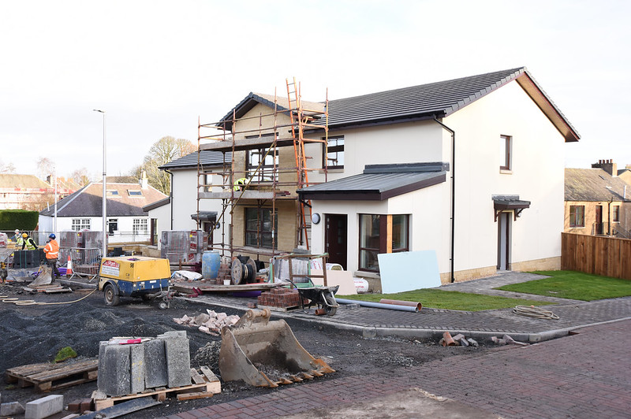


Stock Condition – resident & data driven improvements

Slide 17

Capital Investment in our Homes
Loft insulation:
2023/24: £417K = 258 homes
2024/25: £384k = 280 homes

Slide 18
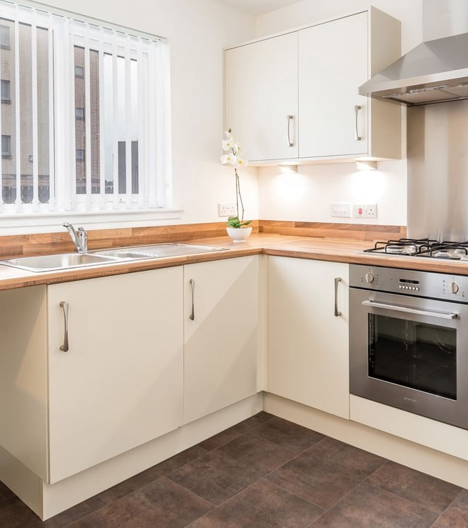
Capital Investment in our Homes
Kitchen & Bathroom replacements:
2023/24: £2M = 284 homes
2024/25: £1.3M = 169 homes

Slide 19
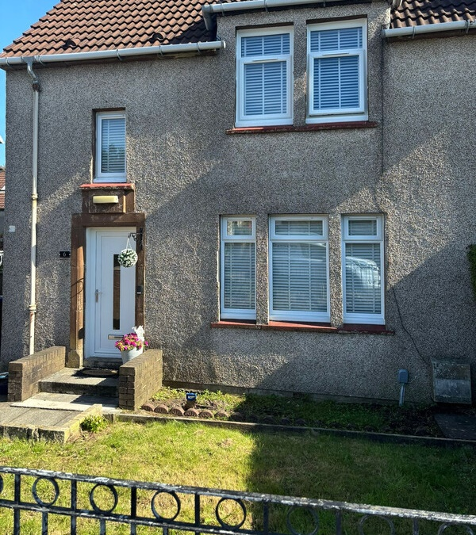
Capital Investment in our Homes
Window & Door replacements:
2023/24: £819k = 104 homes
2024/25: £823k = 121 homes

Slide 20
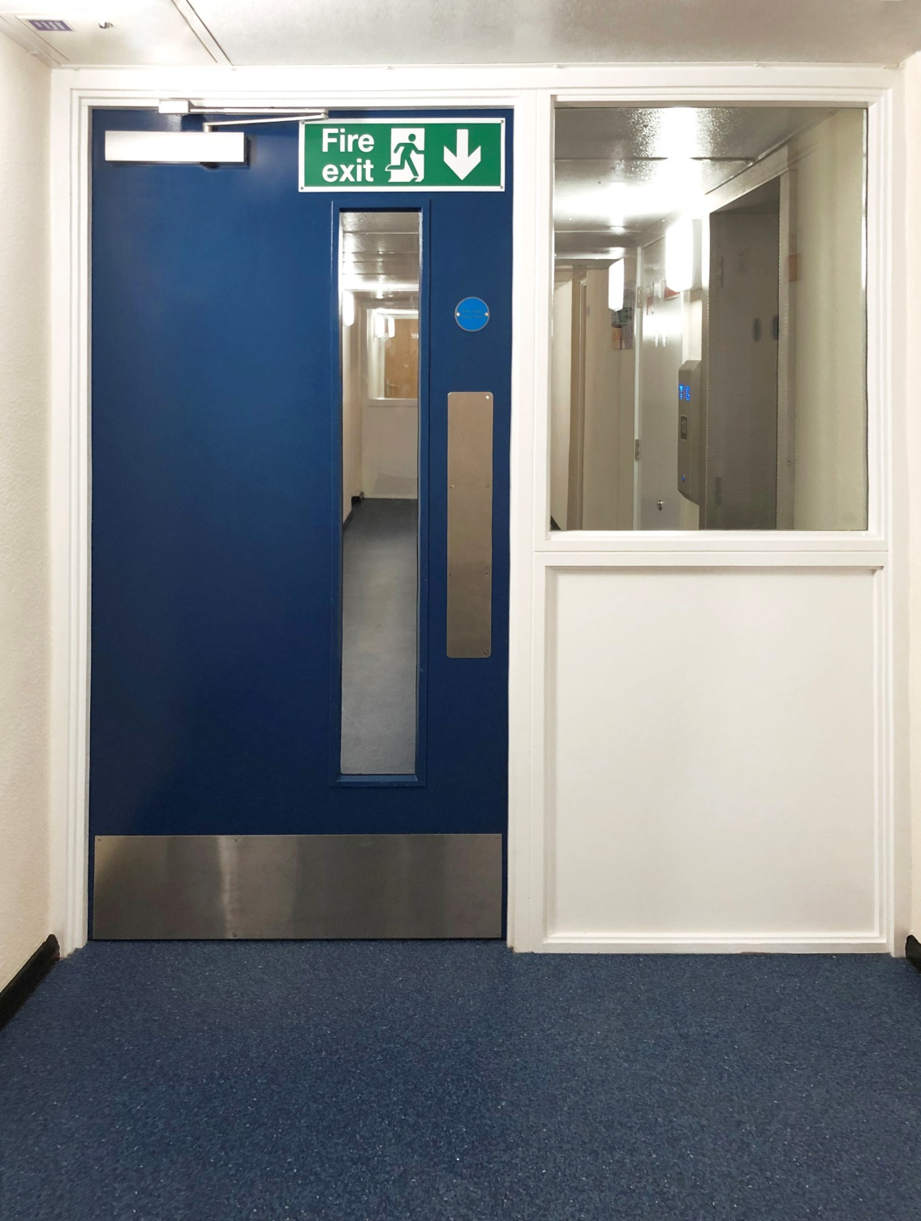
Capital Investment in our Homes
Fire Doors
2023/24: £5.2m = 918 homes
2024/25: £5m = 892 homes

Slide 21
Next Steps…
We have procured an additional contractor, Trident Ltd, to enable us to increase delivery
… and we are procuring another contractor to support Housing Operations
We have increased spending on Decent Homes works
We are working even harder to reduce reactive repairs by improving planned maintenance (70:30)

Slide 22

Next Steps…
This year the HRA Capital programme is specifically targeted towards Decent Homes, with just over £20M being spent solely on Decent Homes work.
With the additional contractor we anticipate that we will be able to deliver:
Kitchens & bathrooms = 1068
Boilers = 1176
Windows = 540
Pitched & flat roofs = 444
This will ensure that we improve our Decent Homes position further.

Slide 23

Thank You

Slide 24
Tenants’ Housing Conference – 25 March 2025
The Repairs Service and voids
Mark Mullen – Housing Operations Manager

Slide 25
Housing Repairs & Voids Maintenance
Mark Mullen – Housing Operations manager
25th March 2025

Slide 26
Maintenance and Repairs – Social Housing stock
Direct Labour Organization
Dynamic Procurement Solutions (Estates and Assets)
Maintenance and Repairs Service

Slide 27
Overview of Housing Operations
Housing Operations delivers over £31m per annum repairs and maintenance contractor service using over 390 staff and trades covering five work steams:
Mechanical & Electrical Safety Services
Contracts and Commercial Services
Housing Estates Repairs and Maintenance
Housing Estates Voids Maintenance
Employment and Logistics
A proportion of this work includes non-housing work to schools, civic buildings, public carparks, social care, museums, etc.

Slide 28
Overview of Housing Operations
Mechanical & Electrical
£7m pa spend
Gas and Electrical Compliance carrying out 9000 to 9,500 Gas services per annum
5-year periodic Electrical testing program to all of the housing stock;
Day to day gas and electric repairs and maintenance including new installations;
Portable Appliance Testing and fixed appliance testing for SCC, schools and public buildings;
Compliance and safety testing Emergency lighting, Lightening conductors,
Fire alarm testing,
Aircraft & navigation warning lighting testing, ventilation systems, solar/PV, etc.;
Planned works such as: full house rewires/upgrades, new heating installations, etc.
Email: mark.mullen@southampton.gov.uk
Tel: 023 8083 4127

Slide 29
Overview of Housing Operations
2) Contracts and Commercial
£15m pa spend - Major maintenance projects including:
Replacing kitchens and bathrooms;
Fire door replacements; Fire safety work such as fire stopping, ceiling replacements, etc;
Fascia and soffit replacements, replacement water pipe systems to high rise blocks;
Structural works;
External door replacements;
Repointing programs;
Disabled adaptation work;
Special Decoration scheme for elderly customers;
Repairs and maintenance to non-housing properties, public buildings, assist office moves.
Damp Reduction Initiative (DRI) surveys and proactive repairs

Slide 30
Overview of Housing Operations
3) Housing Estates Repairs and Maintenance
£7m pa spend across the city’s housing stock
A 24/7, 365 days a year responsive repairs service to 16,000 properties & 3,000 leaseholders.
Inc. extra care flats & general needs – representing 1 in 5 properties in the city.
We carry out around 55,000 repairs pa
We are the eyes and ears of the Council reporting Safeguarding concerns.
4) Housing Estates Voids Maintenance
£4m pa spend across the city’s housing stock
Includes Kitchen & bathroom replacements, rewires, replacement and/or new heating
1,000 void property maintenance pa.
Work closely with Housing Management to improve areas where our customers live.

Slide 31
Overview of Housing Operations
5) Employment and Logistics
£7.5m material, plant and equipment spend pa (Embedded within the £31m)
Manage supply chain inc. £4.3m pa contract with Travis Perkins. This includes:
  Annual price reviews
  Monthly performance review meetings & product reviews
Manage the delivery drivers to supply materials and plant to trades across all areas;
Staff recruitment and training.
Manage apprenticeship scheme – currently 15 apprentices.
Management of our waste transfer station managed by our Waste, Fleet & Facilities Manager:
  Waste Management (Hazardous & Non-hazardous)
  Collection of asbestos waste & asbestos fly typing
  Administer approx. 300 vans - MOT, Servicing/ repairs, Replacements, etc

Slide 32
Current Ongoing Challenges
Lack of planned maintenance investment (45% of Housing Stock requiring £41m to meet Decent Homes Standard)
Driving an increase in major ad-hoc planned work repairs leading to:
  Longer timescales for completing responsive and void maintenance work.
  Back log of responsive repairs and void properties
  Volume of repairs phoned in has remained doubled in the last 12 months
  Volume of complaints have risen by more than 550% in last four years, largely due to delays in repair work
  Rise in damp and mould cases
  Increase in disrepair claims

Slide 33
Current Responsive Repairs Performance
KPIs
KPI Description | Target | End 2023/24 | Year to-date Jan 2025 (44 Weeks) | RAG against target | Improvement progress
Jobs Outstanding | 1000 | 3993 | 3036 |  | ⇩ | 24%
Right First Time (%) | 96% | 78.56% | 81.49% |  | ⇧ | 4%
Routine & Major repairs completed on time (%) | 99% | 51.30% | 86.05% |  | ⇧ | 68%
Emergency completed on time (%) | 100% | 94.89% | 85.77% |  | ⇩ | 9%
Average Calendar days to complete (Routine) repairs | 25 | 30 | 21.21 |  | ⇩ | 29%
Average Calendar days to complete (Major) repairs | 60 | 119 | 146 |  | ⇧ | 22%
Gas Servicing and Safety compliance | 100% | 99.84% | 99.78% |  | ⇩ | 0.06%

Slide 34
Current Void Maintenance Performance
KPIs
KPI Description | Target | End 2023/24 | Year to-date Jan 2025 (44 Weeks) | RAG against target | Improvement progress
Net balance of voids | 60 | 416 | 395 |  | ⇩ | 7%
Average Turn Around Time for Routine Voids (days) | 10 | 133 | 118 |  | ⇩ | 11%
Average Turn Around Time for Non-Routine / Major Voids (days) | 65 | 278 | 334 |  | ⇧ | 20%
Voids IN compared to 12 months ago |  |  | 671 (213 more) |  | ⇧ | 31.74%
Voids OUT compared to 12 months ago |  |  | 637 (275 more) |  | ⇧ | 43.17%

Slide 35
Improvements over last 12 months
Responsive Repairs & Void Maintenance:
Assess demand against capacity
Increase staff & trades
Redeploy trades from other teams to clear backlogs
Adjust van stocks to improve right first time
Extra supply locations to increase material availability
Lock trades to specific work areas to reduce travel time
Review and manage trade productivity
Responsive Repairs & Void Maintenance:
Trade briefings to identify factors causing delays
Daily & weekly team catch-ups to speed-up problem solving
Involvement with Tenant Repair Groups
Lessons learnt from customer feedback and complaints
Pre-termination property inspectors to assist tenants completing repairs before vacating
Drive down and reduce material delays
Email: mark.mullen@southampton.gov.uk
Tel: 023 8083 4127

Slide 36
Improvements over last 12 months
Input and support from other departments and teams:
  Advance notice to allocations team of void properties two weeks before ready for letting
  Review whole end-to-end void process to target and reduce delays at stage of the void process
  Proactive interaction with other departments to speed-up the turnaround times of activities /tasks
  Increased resources to reduce turnaround times and backlogs
  Improve stock investment decisions to unlock properties with long-term high-cost maintenance needs
Email: mark.mullen@southampton.gov.uk
Tel: 023 8083 4127

Slide 37
Improvements over next 12 months
Repairs and Void Maintenance:
  Increased property tenancy inspections – target 20% of Housing stock per annum
  £25m increased capital investment over next five years
  Procure an additional planned works contractor to clear backlogs sooner by 2026
  Digital transformation across Housing Operations -> increase efficiencies
  Single reporting system to improve void management
  Daily bidding of void properties from April 2025 to advertise properties earlier
Email: mark.mullen@southampton.gov.uk
Tel: 023 8083 4127

Slide 38

Damp & Mould Update
Update 2022-23

Slide 39

Primary Cause of Mould in SCC’s Housing Stock
60%
28%
12%
Condensation
Penetrating Damp
Rising Damp

Slide 40
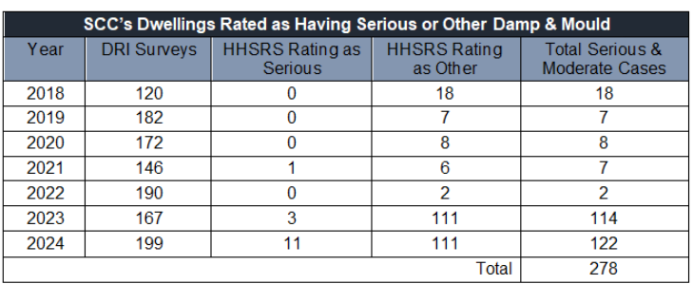
DRI Survey Data
60%
28%
2%

Slide 41
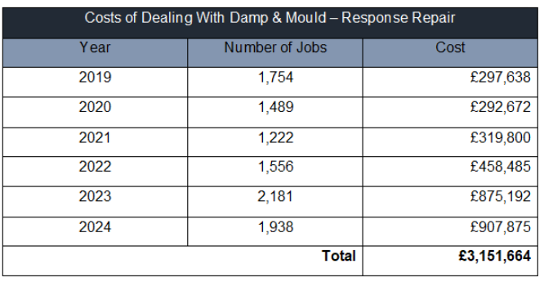
Damp & Mould Cost

Slide 42
Six Stage Process
1. Call centre assessment and advice
2. Trade Operative Inspection
3. Area Manager review or inspection
4. DRI Survey – full technical inspection
5. Follow up survey
6. Planned investment consideration

Slide 43
Performance
Number of damp & mould DRI surveys | 134
Number of reports of damp and mould received by Call Centre | 1713
Properties with a very high risk of developing damp or mould (the total number of unique addresses) | 590
Number of open cases | 514
Average number of days to fix the issue | 46.83

Slide 44
Improvement action plan
Strengthen SCC response – six stage assessment in place.
Investment led approach – dedicated budget for damp and mould (£1,4M) and increase investment in property estate (extra £7m).
Identify opportunities – property estate has been full risk assessed and ranked.
Supporting resident - six stage assessment in place and briefing sessions held with colleagues and surveyors.
Reporting – damp and mould performance is reviewed monthly.
Increased resource investment – dedicated surveyor + more recruited
Policy development – planned for 2025/26
Education - in progress

Slide 45
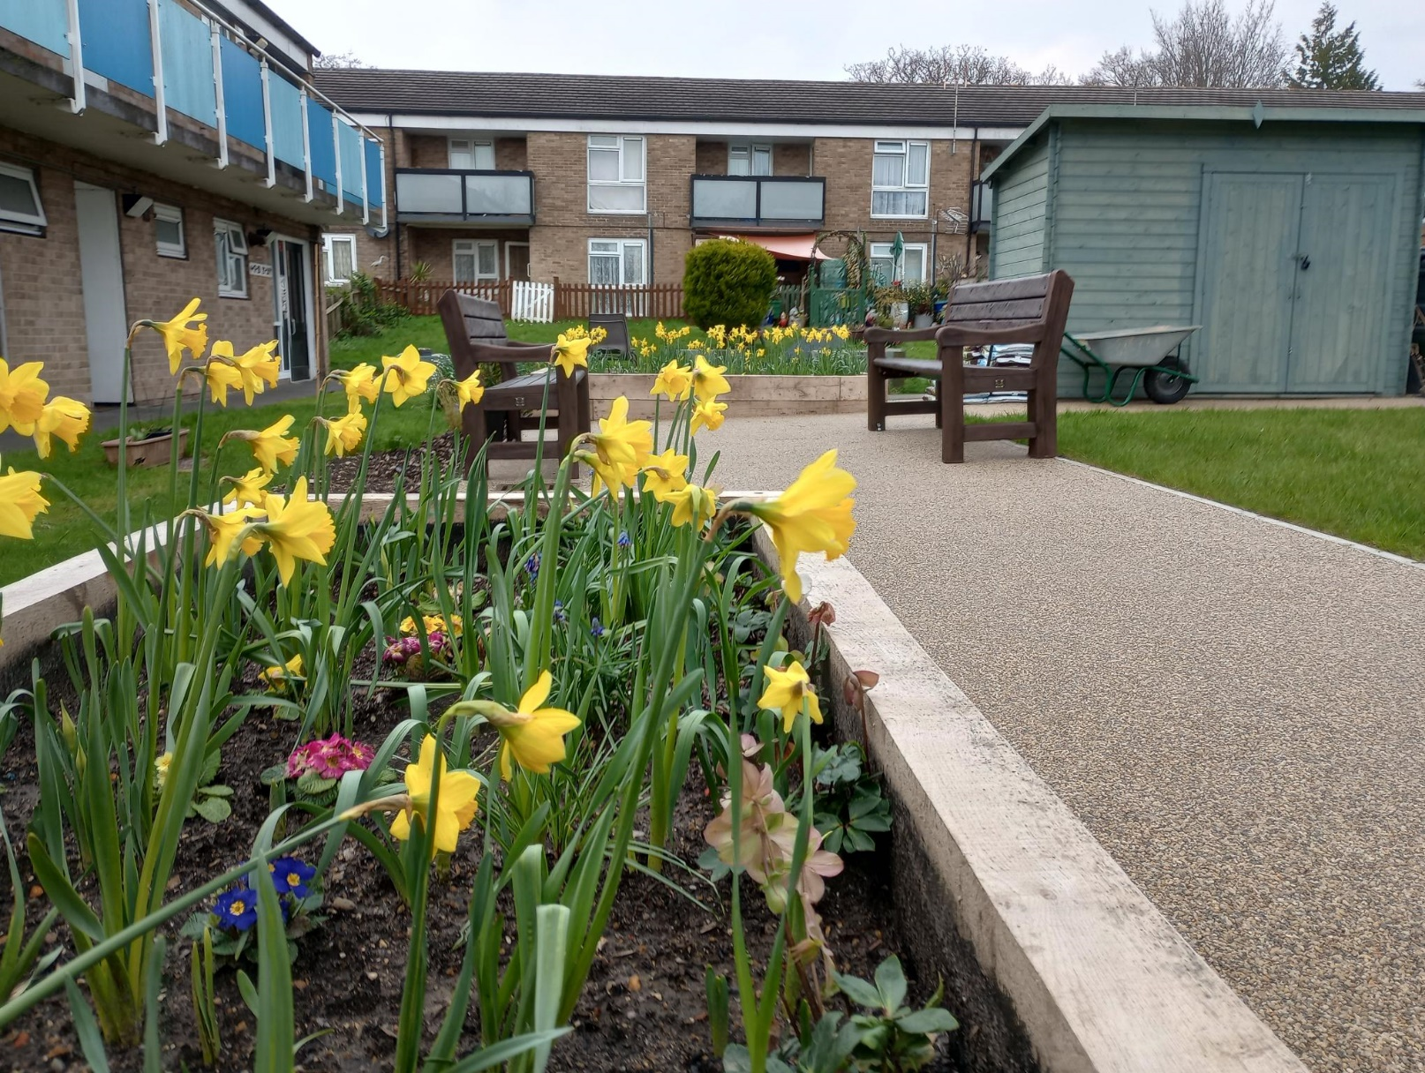
Social Value in Housing Projects
What is social Value?
  Providing added benefits within the community
  Supporting improved facilities, aesthetics and accessibility
  Help address environmental wellbeing concerns
How?
  Funding through partners
  0.5% of spend through primary material supplier Travis Perkins
  Support funding of a range for community-based projects
Email: mark.mullen@southampton.gov.uk
Tel: 023 8083 4127

Slide 46
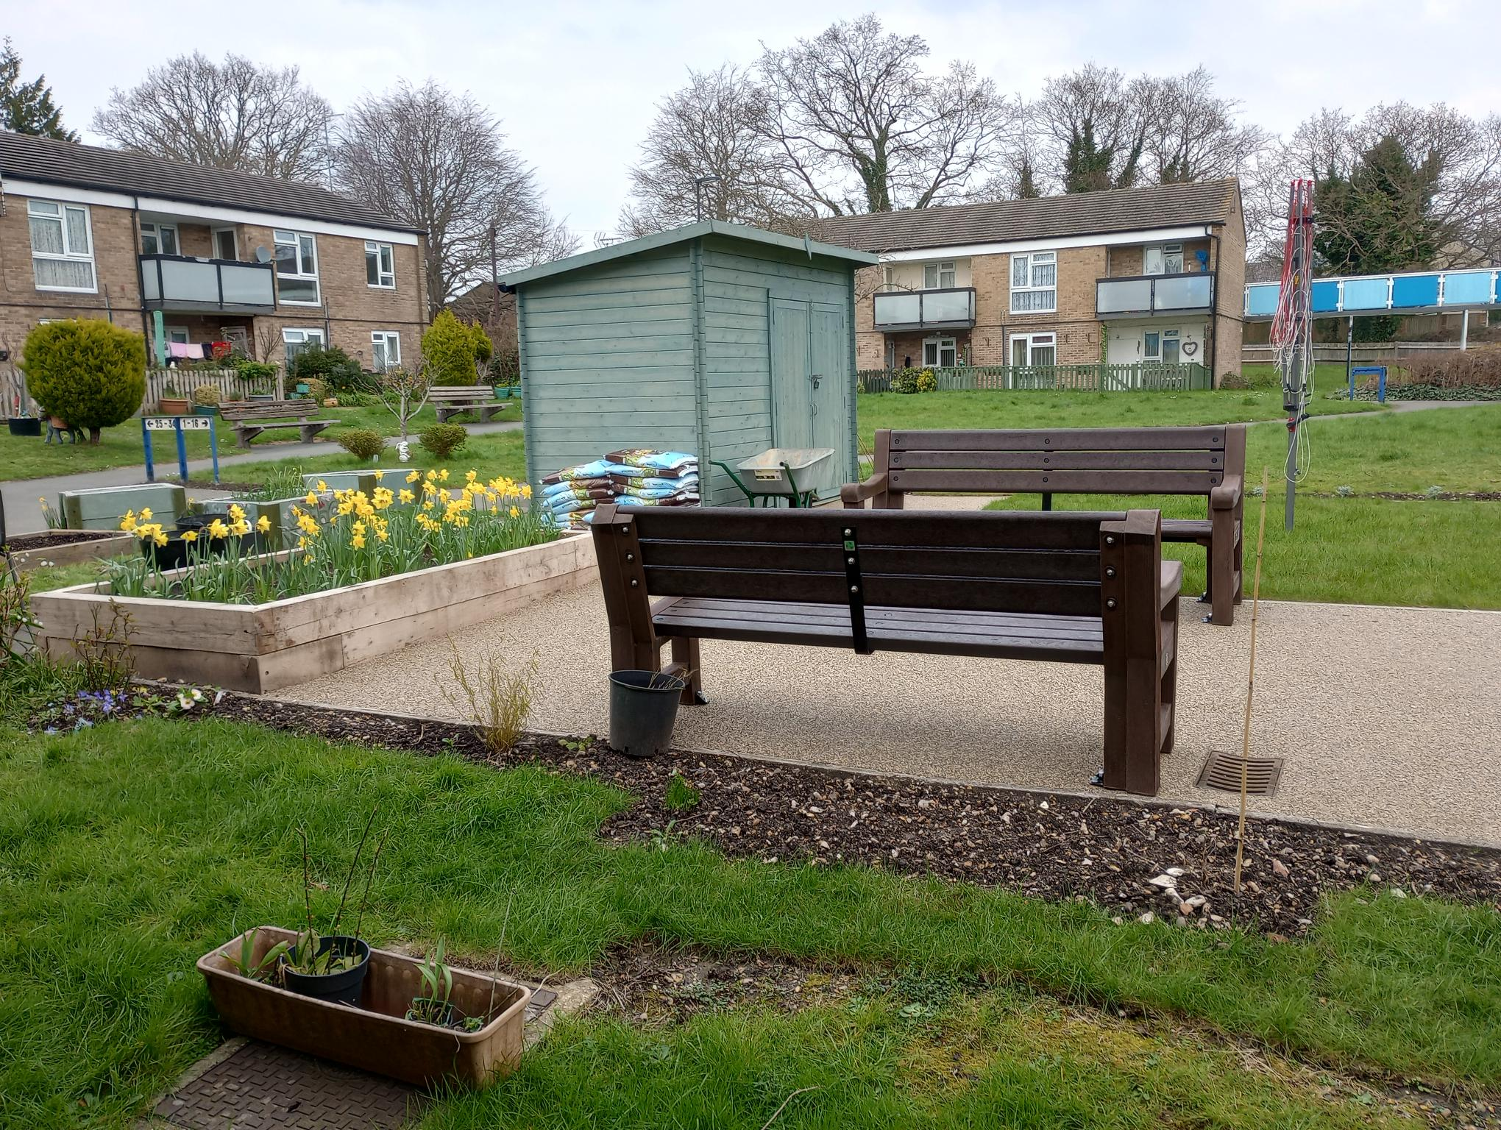
Social Value in Housing Projects
Projects over the last 12months
  Cameron Court community garden
  £10k grant
  New raised beds
  Footpaths
  Shed
  Improved bin area
Email: mark.mullen@southampton.gov.uk
Tel: 023 8083 4127

Slide 47
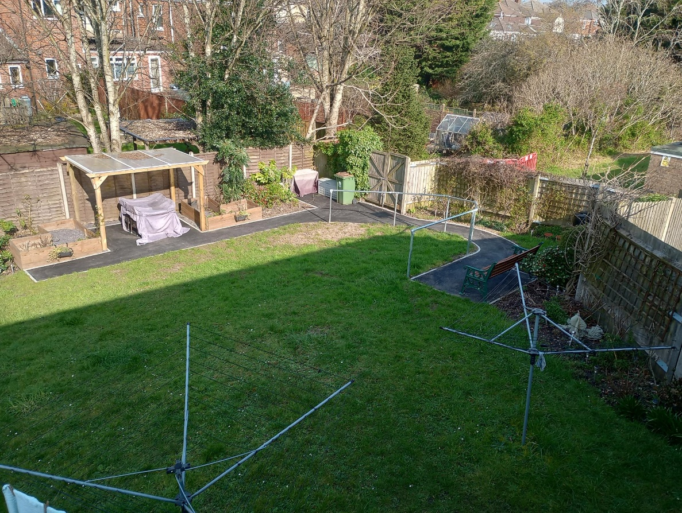
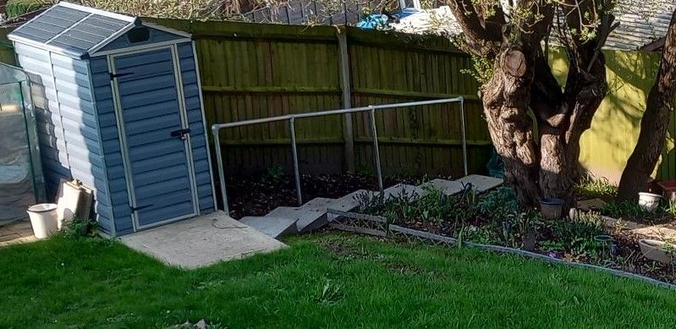
Social Value in Housing Projects
Projects over the last 12months
  Lower Mortimer Road community garden
  £10k grant
  New sloped footpath with handrail to improve accessibility for mobility users
  New steps and handrail to enable residents participate in community gardening
  Better access to seating areas
Email: mark.mullen@southampton.gov.uk
Tel: 023 8083 4127

Slide 48
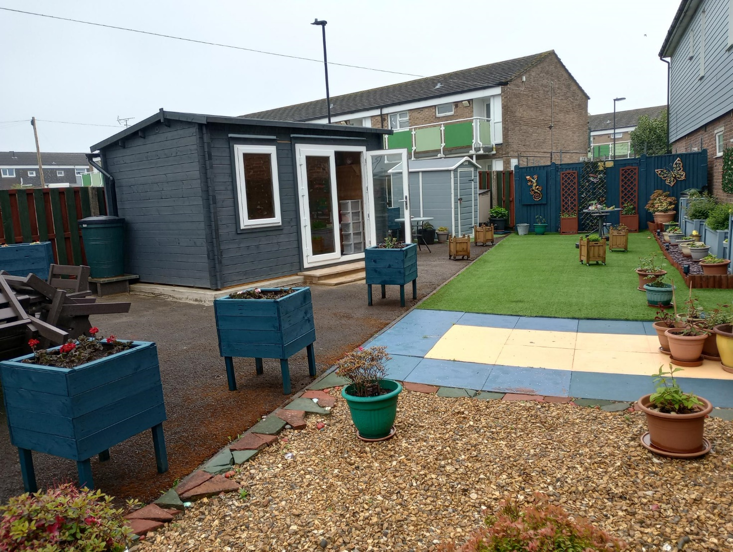
Social Value in Housing Projects
Projects over the last 12months
  Drummond Court summerhouse
  £9k grant
  New sloped footpath with handrail to improve accessibility for mobility users
  New steps and handrail to enable residents participate in community gardening
  Better access to seating areas
Email: mark.mullen@southampton.gov.uk
Tel: 023 8083 4127

Slide 49
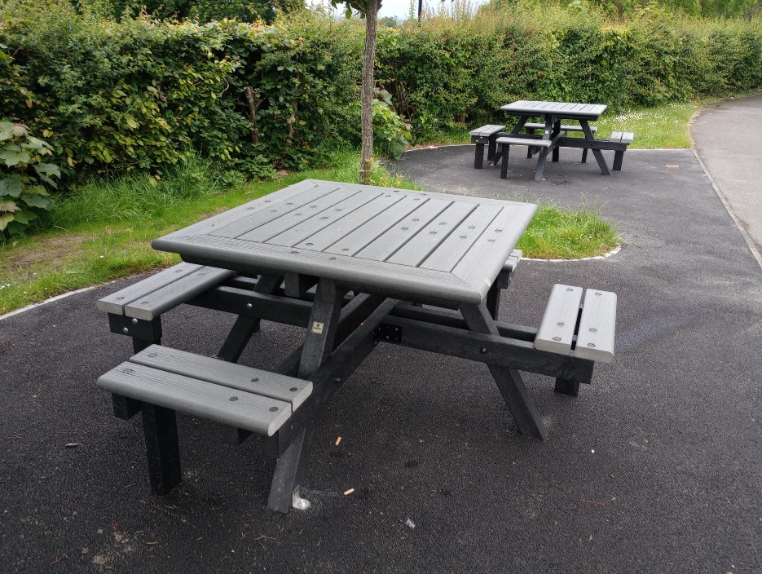
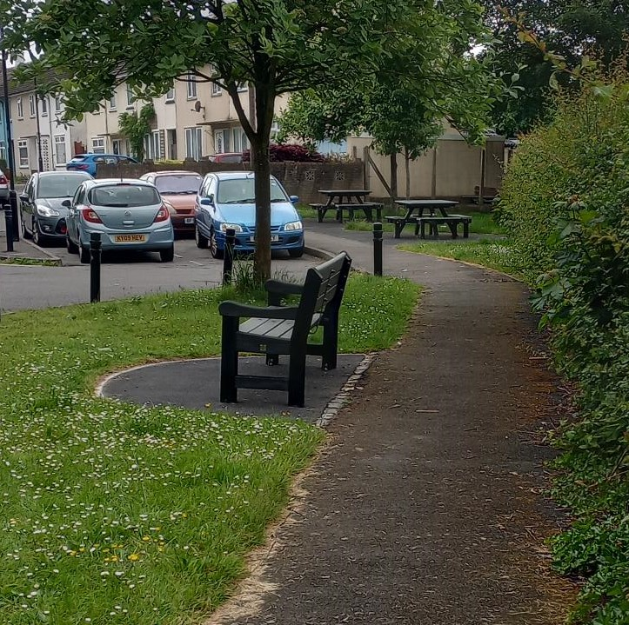
Social Value in Housing Projects
Projects over the last 12months
  Sunset Gardens (Wharncliffe Road)
  £10k grant
  Outdoor seating for residents
  Picnic & park benches
Email: mark.mullen@southampton.gov.uk
Tel: 023 8083 4127

Slide 50

Please download and install the Slido app on all computers you use
How do you prefer to complete repair customer surveys?
ⓘ Start presenting to display the poll results on this slide.

Slide 51
Please download and install the Slido app on all computers you use
Would you like to become a Tenant/resident representative for our repairs and maintenance programme?
ⓘ Start presenting to display the poll results on this slide.

Slide 52
Please download and install the Slido app on all computers you use
How can we improve the way we give details of your repair orders / requests?
ⓘ Start presenting to display the poll results on this slide.

Slide 53
Tenants’ Housing Conference – 25 March 2025
Break time!
Please visit stall at the other end of the room

Slide 54
Tenants’ Housing Conference – 25 March 2025
Break time!
Please visit stall at the other end of the room-… with lots of useful information from NFS Mediation, Neighbourhood wardens, Welfare rights, Community safety, Leasehold service, Local housing office representatives, IDVA (domestic abuse), City Telecare, Supported Housing, Decent Neighbourhoods, TEEMS (employment), ASB (anti-social behaviour), Family hub, unpaid carers and Fostering service

Slide 55
Tenants’ Housing Conference – 25 March 2025
Complaints
Matt Luik - Service Manager Quality, Assurance & Development

Slide 56

Complaints
What is a complaint?
Why are complaints important?
The complaints process
The complaint handling code
Housing’s complaint performance
Learning and improvements
Notes:
Welcome back everyone. This next section of the conference is about complaints. We will specifically be looking at:

Slide 57

Service Request Vs. Complaint
A service request is a request from a resident to the landlord, requiring action to be taken to put something right . Service requests are not complaints. Examples of service requests include -
A request for a repair to be completed when made for the first time
Concern about a neighbour’s anti-social behaviour (ASB)
A problem accessing / interpreting rent or service charge accounts
The Housing Ombudsman defines a complaint as:
“An expression of dissatisfaction, however made, about the standard of service, actions or lack of action by the landlord, its own staff, or those acting on its behalf, affecting a resident or group of residents.”
You do not have to use the word ‘complaint’ for it to be treated as such.Examples of a complaint include -
“you have sent someone out three times to fix the communal door intercom but it is still not working and it is impacting my deliveries”
“You have done nothing about the ASB i’ve been reporting to you over the last year. I don’t think you are taking the case seriously”
Notes:
Effective complaint handling enables residents to be heard and understood. The starting point for this is a shared understanding of what constitutes a complaint .
It’s easy to misunderstand the difference between service requests & complaints

Slide 58
Value of Complaints
Complaints Process
Stage 1. SCC investigates. Acknowledging within 5 working days, responding within a further 10 . Outcomes:
  Upheld
  Partially upheld
  Not upheld
Stage 2- If you do not agree with the actions or decisions made at stage 1, you can escalate to stage 2. SCC acknowledging within 5 working days and responding within a further 20 days.
Tenants Review Panel
Formal review by the Complaints Resolution Team
Ombudsman- If you have completed our complaint process and the issues have not been resolved you can take a complaint to the Ombudsman.
Unfiltered source of insight
Insight into what is important
Are policies resulting in unfair outcomes?
Avoids damage to the Council
Notes:
VALUE- Why are complaints important?
Complaints are a vital tool for improving residents' lives and landlords' services by promoting transparency, holding landlords accountable, and encouraging a culture of learning and continuous improvement.
Complaints are a key mechanism to identify areas where landlords can improve their services and better address residents' concerns.
Complaints encourage landlords to learn, prevent service failures from being repeated and to improve their overall performance.
PROCESSS- In terms of the process, it’s really important that we make the complaints process easy and accessible. There are two stages within the Council’s complaint process
Stage 1- there is an issue where you think we have not taken the right action. you let us know, making clear about what has gone wrong. We work with you to investigate, put things right & resolve the issue. We will let you know if your complaint is upheld, partially upheld, or not upheld…
“Upheld," means the complaint has been found to be justified and we need to take action to rectify the issue
Stage 2- if you are still dissatisfied after you receive a stage 1 response, you can request to progress your complaint to the Council’s final stage (stage 2).
Ombudsman- if you have completed our complaint process and the issues have not been resolved or if we are not responding, you can bring the complaint to the Housing Ombudsman.
OK… we have a quick couple of SLIDO polls for everyone now…

Slide 59
Please download and install the Slido app on all computers you use
Do you find it easy to make a complaint
ⓘ Start presenting to display the poll results on this slide.

Slide 60
Please download and install the Slido app on all computers you use
What would make it easier to complain?
ⓘ Start presenting to display the poll results on this slide.

Slide 61
What is the Complaint Handling Code?
Coming into affect on the 1st of April 2024, The code sets out the statutory requirements for landlords to effectively and fairly respond to complaints .
The Code aims to support the earliest resolution of complaints while matters are still within the landlords own procedure
The heartbeat of the code is enabling a positive complaints culture across the social housing sector
For residents, the code is a guide of what can be expected when a complaint is made to a landlord. It also gives information on making and progressing a complaint
The Ombudsman monitors compliance with the code. Non compliance with the code can result in a landlord being issued a complaint handling failure order
Notes:
Coming into affect on the 1st of April 2024, The code sets out the statutory requirements for landlords to effectively and fairly respond to complaints .
The Code aims to support the earliest resolution of complaints while matters are still within our own procedure
The heartbeat of the code is enabling a positive complaints culture
For residents, the code is a guide of what can be expected when a complaint is made. It also gives information on making and progressing a complaint
The Ombudsman monitors our compliance with the code. Non compliance with the code can result in us being issued a complaint handling failure order

Slide 62
Complaint Handling Code
Definition – what is a complaint?
Exclusions – what will not be treated as a complaint
Accessibility – making it easy to make a complaint- meeting the requirements of the Equality Act 2010 and offering reasonable adjustments where appropriate
Staff – landlords should have a designated person or team to respond to complaints
Process – sets out a clear 2 stage complaints process
Stages – sets out the timescales to provide a response at both stages including the use of extensions
Putting things right – considering the impact on the resident and setting out what will be done to put things right
Self-assessment – landlords must complete an annual self-assessment of their compliance against the Code
Scrutiny – appointing a Member Responsible for Complaints to have responsibility and accountability for complaints
Notes:
All the sections are important, but sections worth pointing out:
Accessibility- We must make it easy for residents to complain. Residents must be able to raise their complaints in any way and with any member of staff. We must have a single policy in place for dealing with complaints
Stages- Complaints have to be responded to within timescales. Complaints have to be logged, acknowledged & defined.
Stage 1 complaints need to be acknowledged within 5 working days and a full response within a further 10 working days.
Stage 2 complaints need to be acknowledged within 5 days and a final response issued within a further 20 working days
Putting things right-
Where something has gone wrong we must acknowledge this and set out the actions we have already taken, or intend to take, to put things right. These can include:
apologising
acknowledging where things have gone wrong
providing an explanation, assistance, or reasons
taking action if there has been delay
providing a (financial) remedy
changing policies, procedures, or practices
reconsidering or changing a decision
amending a record or adding a correction or addendum
To ensure complaint handling is complaint with the code. Landlords are required to complete an annual assessment against the code as part of their annual complaint performance and service improvement report.
Within the 9 sections of the code there is a subset of specific 72 requirements. We have self assessed as being non complaint with 3
5.6
When a complaint is logged at Stage 1 or escalated to Stage 2, landlords must set out their understanding of the complaint and the outcomes the resident is seeking. The Code will refer to this as “the complaint definition”. If any aspect of the complaint is unclear, the resident must be asked for clarification.
5.7
When a complaint is acknowledged at either stage, landlords must be clear which aspects of the complaint they are, and are not, responsible for and clarify any areas where this is not clear.
6.12
Residents must not be required to explain their reasons for requesting a stage 2 consideration. Landlords are expected to make reasonable efforts to understand why a resident remains unhappy as part of its stage 2 response.

Slide 63
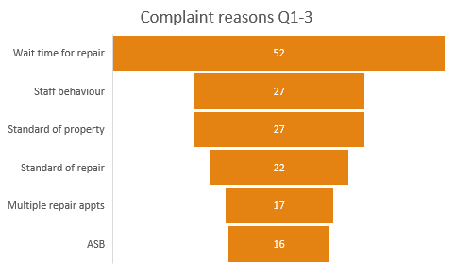
Current position / performance.
Notes:
I’m now going to share some stats and performance information:
Numbers- you can see that 68 Stage 1 complaints were received in the Quarter 3 this year. The number of complaints received has been reducing over the past year. The Regulator reported that we have less than half the national average for a landlord of our size and its tempting to
see this as positive but in fact its more likely indicates a lack of resident awareness of the process or confidence in the landlord . These stats help inform us that we need to concentrate on making the complaints process easier / more accessible.
High volumes must not be seen as a negative.
Timescales - The Timescale for responding to stage 1 complaints is 10 working days. You can see that last month, of the closed complaints, 94.% were responded to within timescale. However, you can see that the results fluctuate. These stats help inform us that we need to do better at hitting targets, while doing a good job. We are introducing new training, a new complaints officer and a new complaints management system to improve these figures. We need to have a closer look at these results, examining trends and considering possible causes- is it seasonal? Are there staff resource considerations?
Reasons- You can see from chart that the main complaint reason over the last 3 quarters is “wait time for repair”. “Staff behaviour” also stands out to me. Stats like these help show us the areas we need to focus on. More closely examining these areas, running focus groups with affected residents. Speaking to service managers, looking at & improving processes / systems / resources.
Re the time taken for repair - It is however worth pointing out that in the last tenant survey, 73 % of tenants are satisfied with the overall repairs service (18 dissatisfied) .
Outcomes-
This chart shows whether complaints over the last 3 quarters have been upheld, partially upheld, or not upheld.
Red being upheld = a justified complaint.
“Upheld," means the complaint has been found to be justified and we need to take action to rectify the issue.
For me, the chart clearly shows too many are upheld. Suggesting that we are not learning. It shows that we need to keep measuring, examining and acting upon these figures. Continued measurement of this will be a good indicator of how we are performing . If we are getting complaints but they are not being upheld ( by both us and the ombudsman) then it will indicate our processes / procedures are robust . But we do need to do more work to understand what complaints reasons / areas are being upheld, are issues more prevalent in certain areas?
It is however positive that we are acknowledging and being transparent about the mistakes made.

Slide 64
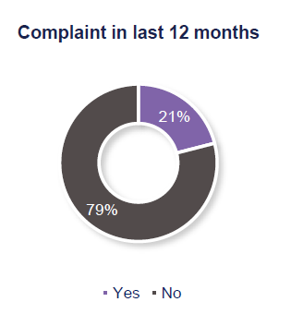
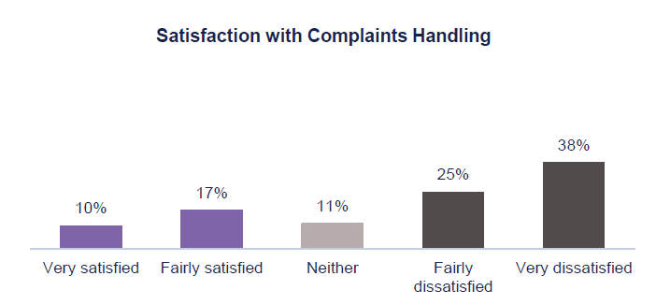
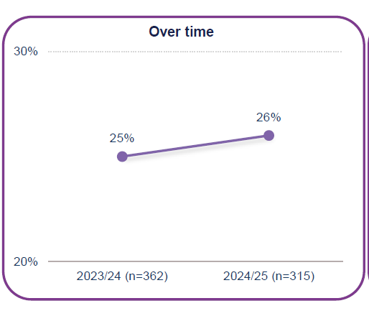
Current position / performance.
Notes:
This slide shows some results from the latest Tenant Satisfaction measure survey.
As part of the Tenant Satisfaction measure survey, approximately 1500 Tenants were asked if they had made a complaint to SCC in the last 12 months, 21% of tenants stated they had.
Of these tenants, just over a quarter are satisfied with how SCC handle their complaints (26%), a 1p.p increase since 2023/24.
While this is not a good result, its worth giving some context in that, when benchmarking against other Local authorities, the top of the highest performing LA’s is 42%. The Median average is 35%. Everyone needs to do better, but it is perhaps also representative of general underreporting with satisfaction & how people are understandably more likely to report dissatisfaction. But this doesn’t mean that there are satisfied residents. They are just not motivated to report.
Its also important to mention Housing’s Regulatory inspection in August 2024 highlighted the following areas that need to be improved regarding the complaints process:
•Tenant Engagement in the complaints handling process
•The number of complaints received by the service is low compared to other authorities
•Information on how to make a complaint is not easily assessable to tenants
•The process is inconsistent, and response timescales are not being met
•Scrutiny and reporting on complaints is not robust
This is broken down into 10% of tenants being very satisfied and 17% of tenants being fairly satisfied.
Dissatisfaction with this measure is at 63%, a 1p.p increase since 2023/24.
This is split into 25% of tenants being fairly dissatisfied and a further 38% of tenants being very dissatisfied.
This is often the lowest-scoring metric across the sector and is also the case for this survey.

Slide 65
Please download and install the Slido app on all computers you use
What three words represent good complaint handling to you?
ⓘ Start presenting to display the poll results on this slide.

Slide 66
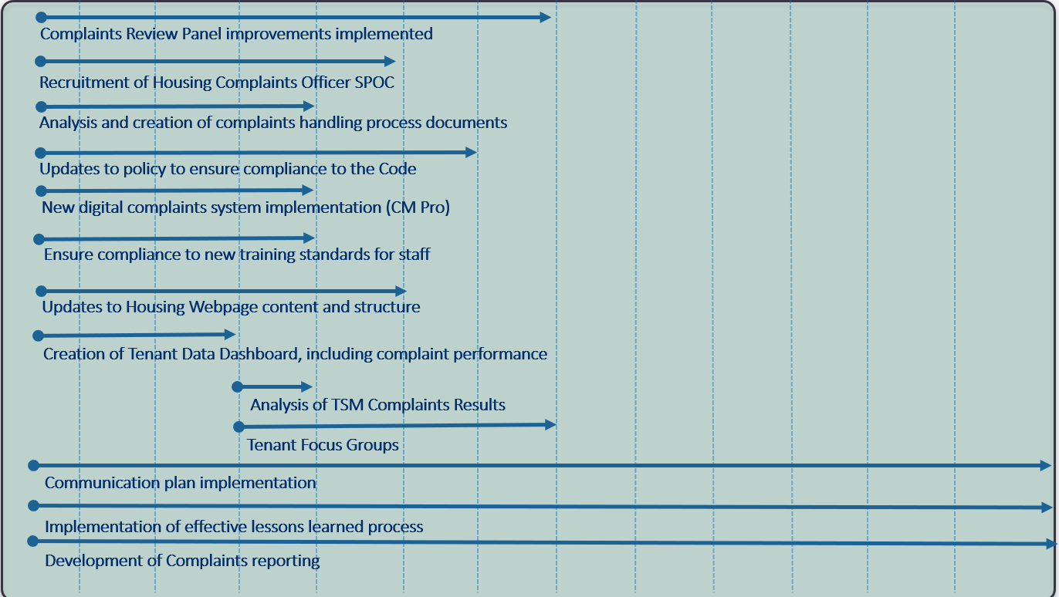
Learning & improvements
Completion of the complaint self-assessment. Identification of gaps and development of an action plan
Development of improved staff complaint training
Improved complaints information on our webpages. Include performance data and information about the Housing Ombudsman and how to make a complaint
Recruitment of a new Housing Complaints Officer
New Complaint management system to be introduced
Complaint processes being reviewed , improved & documented
Introduction letter templates for staff to use to ensure consistency of response
Development of a communication plan focused on informing tenants about their right to complain
Inform, involve & feedback to residents
Notes:
Reflecting on our performance and feedback from the Regulator and Ombudsman, we have developed a complaints improvement plan. Some tasks we have completed, some are underway & some are planned.
I’ve picked out a few important pieces of the plan:.
In conclusion, Its clear we need to improve how we manage complaints. We have initiated and are committed to making improvements and will continue to work hard to deliver the best possible service.
-All relevant staff must be suitably trained . It is important that complaints are seen as a core service and must be resourced to handle complaints effectively . We need to prioritise complaint handling and a positive culture of learning from complaints .
-Encourage involvement with the complaints process-
A lack of awareness about the complaints process may result in missed opportunities to identify and address systemic issues or reoccurring problems.
We need to actively promote the complaints process as a mechanism for residents to report issues, provide feedback, and to contribute to continuous improvement efforts.
-Need to establish robust feedback mechanism – ensure residents have a voice in shaping the complaints process, leading to greater transparency, accountability and satisfaction. Regular feedback and analysis enables continuous improvement and helps address emerging issues proactively

Slide 67
Tenants’ Housing Conference – 25 March 2025
Housing Budget/HRA summary and forecast of spend
Jonathan Evans – Finance Business Partner

Slide 68

Housing Revenue Account – Budget Update
Jon Evans – Finance Business Partner

Slide 69
What is the Housing Revenue Account?
A “Ring-fenced” account - tenants’ rents and service charges are kept separate from other council finances
It does pay for landlord responsibilities (e.g. repairs and maintenance)
It does not pay for council-wide services (e.g. social care, roads, planning)
Governed by legislation - Schedule 4 of the Local Government and Housing Act 1989

Slide 70
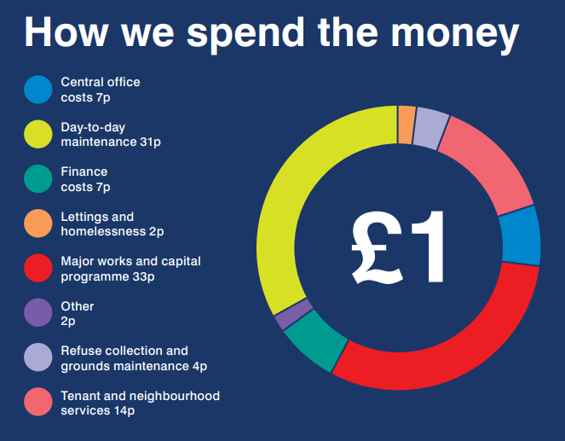
2024/25 Summary
Income - £85.5M
Expenditure - £85.0M
Surplus - £0.50M
Notes:
Pie chart is from 2023/24 Housing Annual Report
Major works & Capital Programme – Revenue contributions to capital
Finance costs – borrowing costs
Day to day maintenance – housing ops
Tenant & Neighbourhood services – Wardens, local housing teams, supported housing
Central office – corporate overheads
Refuse collection & grounds maintenance
Lettings and homelessness – allocations – homelessness is a council responsibility
Other 2p ––disrepair claims and contributions to provision to cover potential future liabilities

Slide 71

2025/26 budget setting and business plan update
2025/26 budget and 40-year business plan updated through Cabinet and Council in February 2025
Rent to increase by 2.7%
Service charges to increase by 2.7%
Heating charges to decrease by 10%
Update of 40-year business plan based on updated assumptions to reflect current financial conditions
inflation, interest rates and rental increases
The capital programme has also been updated to focus on improving the Decent Homes Standard in 2025/26
Review due to take place during the year to ensure the HRA is financially sustainable in the long-term
Notes:
Implications of Government housing policy
Rent increases - Maximum possible rent increase is 2.7% for 2025/26 and proposed CPI+1% for 5 years
Right to Buy (RTB) changes – reduction of discount. Spike in applications prior to changes but potentially less attractive scheme for residents in future
Use of RTB receipts – increased flexibilities in use

Slide 72

Landlord controlled heating charges 2025/26
At end of 2022/23 deficit was £3.5M
Charges increased in 2023/24 and 2024/25 to cover increased costs
Council has benefited from energy procurement contract
Charges for 2025/26 to reduced by 10%
Deficit forecasted to be cleared in 2025/26

Slide 73
Please download and install the Slido app on all computers you use
What is your number one priority in what the HRA (Housing Revenue Account) should spend money on?
ⓘ Start presenting to display the poll results on this slide.

Slide 74
End of presentation
Many thanks for listening

Slide 75
Tenants’ Housing Conference – 25 March 2025
Update on Allocation policy
Maria Byrne - Service Lead - Housing Needs & Welfare Support or Katie Evans

Slide 76
Housing Allocations Policy Changes 2025

Slide 77

What is changing?
The new Allocations Policy was agreed by Cabinet in July 2024.
This policy will be implemented in 2025.
Due to the lack of social homes available in the City the Allocations Policy has been updated to prioritise those households with the highest levels of housing need.
This policy change will come into effect in 2025 and we will be contacting those residents already on the Housing Register to advise of the next steps they need to take to ensure they remain on the waiting list when this change comes in effect.

Slide 78

What is happening and when?
Homebid will be closing in May 2025 and this will be replaced with Southampton Homesearch.
The housing register has opened for registration on the new system, Southampton Homesearch. Applicants need to register before April to ensure they can continue to bid. This is for ALL applicants.
Those who are already registered with a live application on Homebid will be able to continue to bid in the normal way until May 2025. They should continue to report any change in their circumstances in the normal way.
We will be moving to a daily bidding cycle – this means properties will be added as they become available throughout the week. They will be advertised for 7 days to ensure everyone has enough time to bid.
In May the policy is being implemented and we are moving from points to bands….

Slide 79
There are 5 main changes
Points to banding
Refusals
Moving in line with Housing Benefit guidance on bedroom need
Local connection
re-registration

Slide 80

Points to banding
The banding scheme operates by grouping applicants into several bands, which reflect the differing levels of housing needs and local priorities in an allocation scheme.
The banding scheme operates by grouping applicants into 4 priority bands in order of priority.
Bands will range from A-D with A being the highest band.
The banding scheme is considered easier for residents to understand,
and simpler for the housing authority to administer and prioritise those
in most need.
The banding scheme is the predominant allocation scheme in England.

Slide 81

Refusals
Applicants will be able to refuse 2 offers of accommodation without penalty.
After the 3rd refusal the applicant will be placed into band D for 6 months. This is the lowest band.
After this time, (if their circumstances/household has not changed) they will be placed back into the band they were previously in.
If they then refuse 1 further property, they are removed from the waiting list.
Notes:
There are exceptions to this:
If an applicant in Band A1 – which is:
Urgent housing needs: A life-threatening illness or sudden disability – urgent medical
or A2 which is
Urgent housing needs: Those who require urgent re-housing as a result of violence or threats of violence, including intimidated witnesses, and those escaping serious antisocial behaviour or domestic abuse – man moves reciprocals
Refuse an offer of accommodation and the council is satisfied the offer was reasonable, the applicant will be placed into the band they previously occupied. If the applicant did not previously have a band, they will be removed from the Housing Needs Register.

Slide 82

Moving in line with Housing Benefit guidance on bedroom need
Current
Currently children of same sex share regardless of age, and children of opposite sex share until one reaches the age of 10.
New policy
Once a child reaches the age of 16 they will be entitled to their own bedroom. children of opposite sex share until one reaches the age of 10.
What this means?
This will mean an increase in the number of people being eligible for larger properties. However, there is the option to move to a property that improves your current circumstances. For example, a household living in a 1 bedroom property with a 3 bedroom need could move to a 2 bedroom property, as this would alleviate the overcrowding and potentially allow them to move faster. They would then be able to rejoin the housing list for a larger property.
Notes:
.

Slide 83
Local Connection
Current
To have lived in the city for at least 3 year prior to application.
New proposed change includes two other residency criteria:
Lived in city for 3 years
Lived in city for 3 out of 5 years prior to date of application
Have permanent paid employment in the city and to have been in employment for a minimum of 2 years.
This will allow those who have had to leave the city for a period to still be eligible and retain their connection for the purpose of the housing list.
This will be checked each time an applicant re-registers – if they no longer meet this requirement as they have been out of the city for a longer period than the policy allows for, they will be removed from the list and advised to apply to their local authority.
Notes:
Read from slide

Slide 84

Re-Register
Current Policy
At the moment when an applicant applies, they do not need to re-register at any point. They are required to update their details if they change but unfortunately this does not always happen.
New Policy
All applicant’s will be required to re-register annually. We will be designing a short form for this process, so they are not required to complete the full application form again, the new system also has the function where we can remind applicants of their re-registration date.
We will need applicants to re-apply to join the Housing Register – we will allow a 12-month period for applicants to register on the new system. Communication will be sent to those on the housing register when they are required to re-apply.
Notes:
.

Slide 85
Please download and install the Slido app on all computers you use
What barriers do tenants face when thinking about downsizing?
ⓘ Start presenting to display the poll results on this slide.

Slide 86
Please download and install the Slido app on all computers you use
What information/support/incentive would you like/need if you decide to downsize?
ⓘ Start presenting to display the poll results on this slide.

Slide 87
Any questions?

Slide 88
Tenants’ Housing Conference – 25 March 2025
Tenant Engagement Team
Lepša Stojković – Tenant Engagement and Participation Team Leader

Slide 89

Tenant engagement

Slide 90

Meet the team
Notes:
Tenant Engagement team was redesigned and now consists of two Tenant Engagement officers, Junior Neighbourhood Warden Coordinator and the Team Leader. The team provides lots of different opportunities for tenants to get involved, so they can hold us to account and make their voice heard

Slide 91



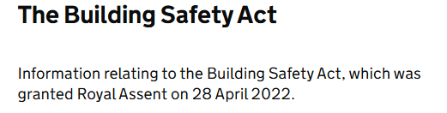
Why have Tenant Engagement

Slide 92
Why have Tenant Engagement
More importantly - we think that engaging tenants is important!
It makes sense
Why wouldn’t we?
Involving tenants should be a given. It’s a good thing. We know it’s the right thing to do
Tenants have a brilliant way of cutting through bureaucracy and contributing new perspectives of being a critical friend
Involving tenants ensures that the decisions are made are the right ones
Notes:
If we don’t understand these things we can’t determine whether we are giving value for money
So we start to see that engaging tenants is a very basic requirement of running our business
What sort of a service do tenants want and need, to what standard, and what do they expect the outcomes to be?

Slide 93

C3
Our judgement is that there are serious failings in the landlord delivering the outcomes of the consumer standards and significant improvement is needed
https://www.gov.uk/government/publications/southampton-city-council/southampton-city-council-00ms-regulatory-judgement-27-november-2024
Notes:
We found serious failings in relation to Southampton CC delivering the outcomes of the Transparency, Influence and Accountability Standard. This standard sets out the outcomes landlords must deliver about being open with tenants and treating them with fairness and respect so that tenants can access services, raise complaints, influence decision making and hold their landlord to account. During the inspection we observed a respectful approach to tenants, but Southampton CC does not have sufficient data to demonstrate how it understands the diverse needs of its tenants nor how its services deliver fair and equitable outcomes for tenants. Southampton CC has identified this as an area for improvement and it is included within the Council’s housing improvement plan.
We also found serious failings in how Southampton CC is using tenant engagement as a mechanism to influence how it delivers its services. We saw no evidence of tenants being meaningfully involved in decision making, or able to challenge Council decisions. Southampton CC informed us it will be producing a new tenant engagement strategy and that tenants will be included on a new advisory panel. We will continue to engage with Southampton CC as it makes improvements to tenant engagement.
Through the inspection, we found Southampton CC could not demonstrate that it regularly provides a range of relevant and accessible information to tenants, including about its performance in delivering landlord services. We found most information for tenants is only readily available digitally and tenants raised poor communication as a concern. Staff and tenants do not have access to all performance information, undermining tenants’ capacity to hold their landlord to account.

Slide 94
Tenant engagement opportunities
We are very committed to tenant engagement and improving the service
Tenants’ association members
Block reps
Forums’ members
Panel members
Conferences
Training – we are required by the regulator to upskill our tenants so they can scrutinise and improve housing services
Taking part in consultations/focus groups/working groups
Social media and WhatsApp
Notes:
Social media: Tenant engagement Facebook group and main Housing Facebook page

Slide 95
Twitter (X)
Facebook
Digital notice boards
Tenant Scrutiny Panel
Tenant Inspectors
Tenant Resource Group
Service Improvement & Scrutiny
WhatsApp
Digital / Interactive Engagement
Sounding Board
Stage 2 Complaints
Tenant Panel
Tenant Repairs Panel
Tenants Link
Building Safety Group
TPAS / Housemark
Decent
Neighbourhood Board
Senior Leadership Team
Complaints Review Panel
Quality & Assurance Board
Consultations
Joint Panel
Equality, Diversity & Inclusion Panel
TENANT ENGAGEMENT AND PARTICIPATION
Thornhill Highrise Forum
Focus Groups
Junior Wardens
Annual Conference
Supported Housing Forum
Estate walkabouts
Tenant Training
Local Involvement
TPAS training
SCC led training
Citywide Involvement
Weston Community Forum
Leaseholder information sessions
South Coast
Training
Central District Forum
Tenant Associations
Block reps
Citywide Block rep Forum
Green Space Monitors
Cleaning Monitors
Notes:
Diagram shows how our TE governance works on TE level.

Slide 96
What have we achieved so far this year
Performance and Housing complaints web pages created
Created Forward plan & governance arrangement
Created the new recommendation and action log recording and monitoring system
TPAS self-assessment
Review of Tenant Engagement Strategy underway - Tenant focus groups being held
Notes:
Production and distribution of the quarterly tenant engagement reports. It summarises the team’s recent activities. There is a wealth of the performance information for residents
Created new Our performance and Housing complaints web pages
TE strategy – Tenant focus group helped

Slide 97
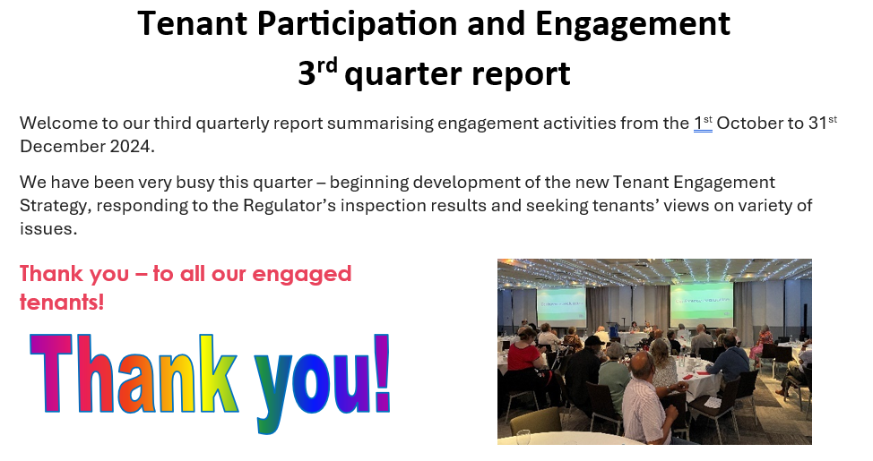
Tenant Engagement quarterly reports
Notes:
Production and distribution of the quarterly tenant engagement reports. It summarises the team’s recent activities. There is a wealth of the performance information for residents

Slide 98


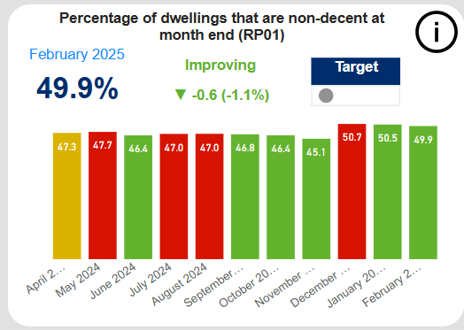

Digital modernisation
Using Slido for consultations
New Housing dashboard
New Housing webpages information content
New Hybrid meetings equipment
Tenant Engagement WhatsApp community

Slide 99


A new training programme running from May and June has been organised.
Helping to:
Learn new skills
Increase digital skills
Build confidence
Help challenge the council
How to book: check out the info in your pack or scan this QR Code

Slide 100


Secured over £15,000 in additional funding
for projects
761 followers
On Facebook
2024/25
Play Day
2000+ Attendees
Engaged with
505 young people
26 Projects
22 Intergen
Sessions
Breaking down generational barriers

Slide 101


What have we achieved so far in this financial year
The Tenant Scrutiny Panel have reviewed the printed sign –up information given to tenants when moving into a property. One of the recommendations was for tenants to be given the option of how they would like to receive this information, via email, printed copy or via the SCC website. Recommending the information is on the website also enables any tenants new or longstanding to view up to date information.
Created a gardening club agreement for use across the city
Produced some questions likely to be raised by tenants for the Q&A on the SCC website about the new housing register taking over from Homebid.
Don’t forget if you were on the Housing list, you will need to register your details to the new housing list

Slide 102
The Repairs panel
The Tenant Repairs Panel have read all the information on
Repairs on the SCC website, to ensure it is readable and clear.
Suggested changes have been sent to the internal web team
as they have just started updating the Housing part of the
website, and this work will assist.
Raised an issue with the Travis Perkins that the Tenant discount is not usable online, it can only be used in stores. A Tenant Link article was organised to raise awareness about the issue.

Slide 103
Building Safety Group
Recommended the creation of the Building safety booklet
Consulted on the Building safety and tenant engagement strategy – suggestions incorporated – strategy shared
Guide on how to stop water in the property – in your packs
Asked for the guide for E-bikes and scooters use
Building safety Risk assessments for blocks
Building safety audit schedule
Raised the issue of electrics safety check
Notes:
Building safety group requested the Building safety information booklet – almost ready to be shared
The group also asked for the instruction on how to stop water in the property - now shared in TL,
working on producing an advice guide together for E-bikes and scooters use- group's suggestion
Consulted on Building safety strategy – incorporated in the strategy and mentioned under “you said we did

Slide 104
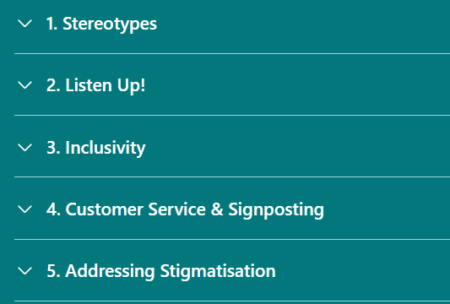
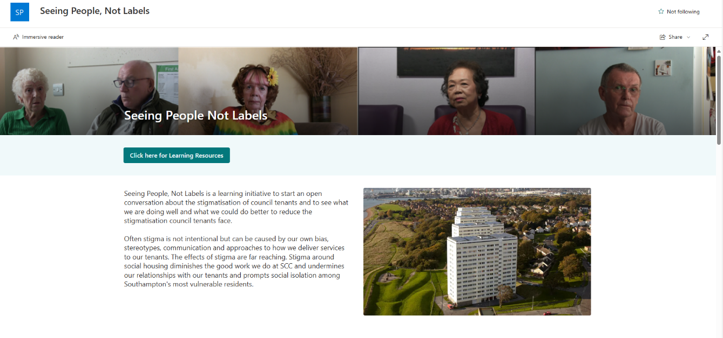
Inspectors
Seeing People, not Labels
Stigma training for staff
SCC have now signed up to ‘Stop Social Housing Stigma’ campaign.
A tenant friendly ASB procedure is now online
Notes:
Seeing People, Not Labels is a learning initiative to start an open conversation about the stigmatisation of council tenants and to see what we are doing well and what we could do better to reduce the stigmatisation council tenants face.
Often stigma is not intentional but can be caused by our own bias, stereotypes, communication and approaches to how we deliver services to our tenants. The effects of stigma are far reaching. Stigma around social housing diminishes the good work we do at SCC and undermines our relationships with our tenants and prompts social isolation among Southampton's most vulnerable residents.

Slide 105

Supported Housing Forum
Visit to Telecare centre
Co-designing the service (tenants and staff)
Please check the online consultation to have your say!
Notes:
Created a separate working group that is working with the Senior managers in supported housing regarding the new service re-design.
C

Slide 106

Shirley Towers tenant making a big difference
A tenant in Shirley Towers is helping to bring about big change locally after becoming a block rep and campaigning for the re-opening of the community room to enable residents to use it
Their first event is taking place at Easter
Notes:
Their first event is taking place at Easter

Slide 107
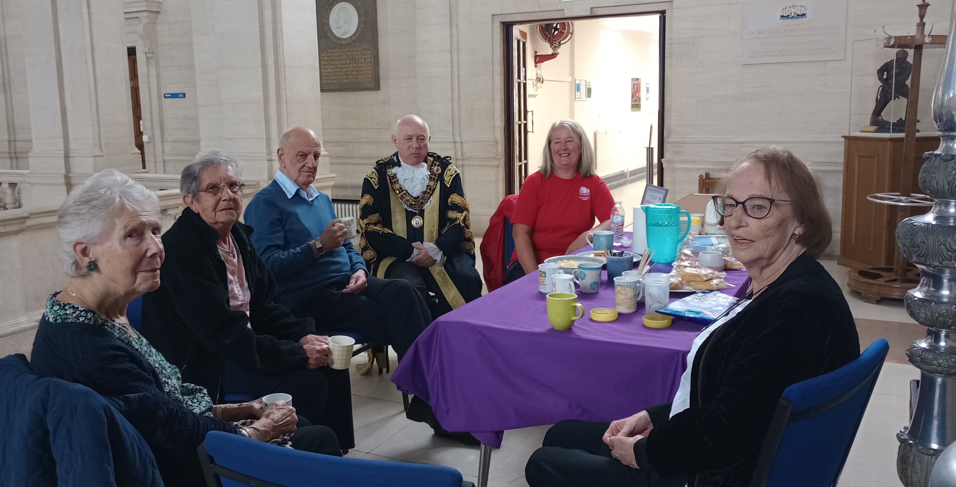
PRADOS Tenant association 20th Anniversary: coffee with the Mayor

Slide 108
46 Roundhill Community Voice fabulous Halloween event
Notes:
Spooky going-ons at Roundhill Close
Back in October, the 46 Roundhill Community Voice (The Tenants Association which covers the newly built block) ran a fantastic Halloween event for the families within the block.
Thanks to grants from the PRIME Foundation and the UK Prosperity Fund, plus with the support of the Tenant Engagement Team they ran a brilliant event with pumpkin carving, apple bobbing, arts and crafts and lots of garden games too. Over 30 residents came out and enjoyed the afternoon and everyone agreed just how good it was. The group were

Slide 109

Leaside Way Gardening Club – Bizzie Bees summer house

Slide 110
This is what Kim said about tenant engagement:
“Having been a Southampton City Council tenant for over 2 decades it felt right for me to explore what influence I could have over how my landlord looks after its residents and housing stock.
I also feel that the shared lived experience of tenants should be an important component in how future decisions are made.”
“I like to feel useful, and it’s good to meet other residents and share experiences.”

Slide 111

Tenant Engagement – the ongoing challenges
Communication
Resources
Culture
Buy-in from the whole of the housing service
Structure
Openness
Ongoing learning process
Inclusion
Notes:
But let’s not pretend - it’s an ongoing challenge:
Because it takes resources
Because it involves setting up formal and informal mechanisms which might challenge traditional decision making structures. Especially in a LA where members are responsible for decision making
Because it’s easier to make assumptions about what tenants want, rather than to ask them.
Because it means we really have to listen, and because people who think they are experts - that’s us -need to be open to challenge
Because none of us can afford to rest on our laurels. We need to open ourselves up to scrutiny which can be a painful process. And finally we need to be prepared to continue developing our mechanisms for involving tenants, and learning from experience.
THANK YOU

Slide 112
Thank you!
The first three quarters this financial year our engaged tenants…
Clocked over 2100 volunteering hours
£26,000
Notes:
Not counting the “home-work”, research, mystery shopping/reports writing/training/leaflet drop etc. If you calculate the volunteer hours at the minimum wage rate of £12.21 it comes down to over £26,000

Slide 113
Please download and install the Slido app on all computers you use
What do you think would encourage more people to get involved?
ⓘ Start presenting to display the poll results on this slide.

Slide 114
Please download and install the Slido app on all computers you use
Do you have any suggestions for the new ways for tenants to be involved?
ⓘ Start presenting to display the poll results on this slide.

Slide 115
Tenants’ Housing Conference – 25 March 2025
Question time!
Matt Luik - Service Manager Quality, Assurance & Development

Slide 116
Tenants’ Housing Conference – 25 March 2025
Conference
polling evaluation
Matt Luik - Service Manager Quality, Assurance & Development

Slide 117
Tenants’ Housing Conference – 25 March 2025
Thank you and close
Matt Luik - Service Manager Quality, Assurance & Development

