Slide 1
Managers Guide to the
Online Risk Assessment System
What to do when you receive an email notification

Slide 2
Why have I received an email?
You have recently had a Fire Risk Assessment (FRA) completed either by SCC or 3SFire.
The FRA has been uploaded onto our online health & safety management system (HSMS)
Actions have been uploaded onto the system that require your attention in completing.
The system allows both you and the council to monitor rectification of the actions raised during the FRA and annual reviewing.

Slide 3
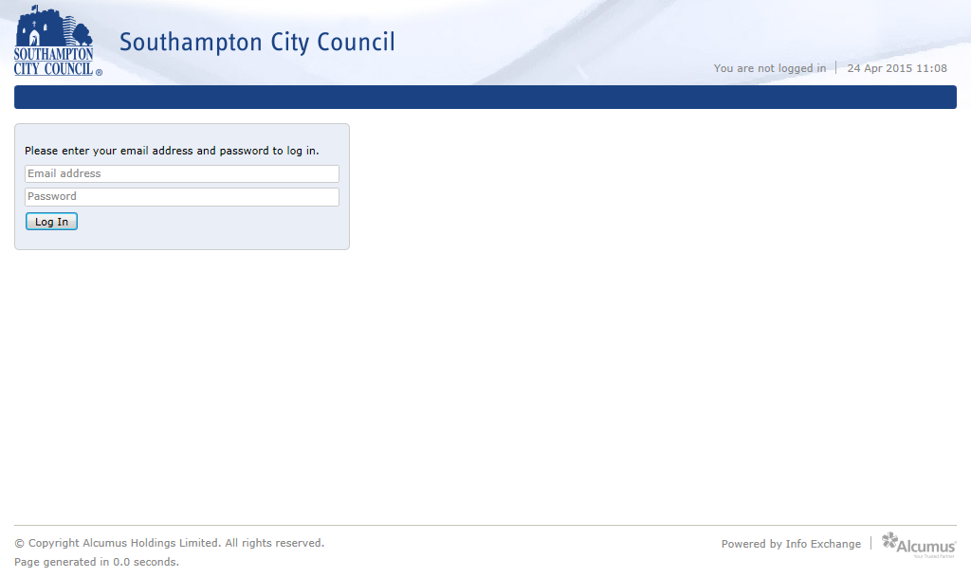
How do I review my FRA and the actions set by the assessor?
To access the log in page, click on the link below or type the following address into your browser: https://scc.info-exchange.com/Default.aspx
This will take you to the log in screen. If you do not yet have your log in details or have forgotten them please request them by calling the Health & Safety Service on 023 8091 7770 (option 2).

Slide 4
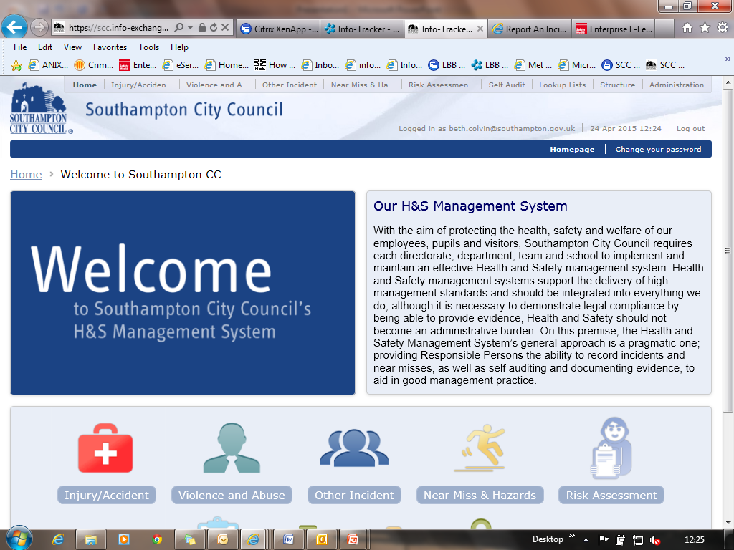
How to view your Fire Risk Assessment
Once you have logged in you will see the Health & Safety Management System home page:

Slide 5
To view your Fire Risk Assessment click on the logo below:

Slide 6
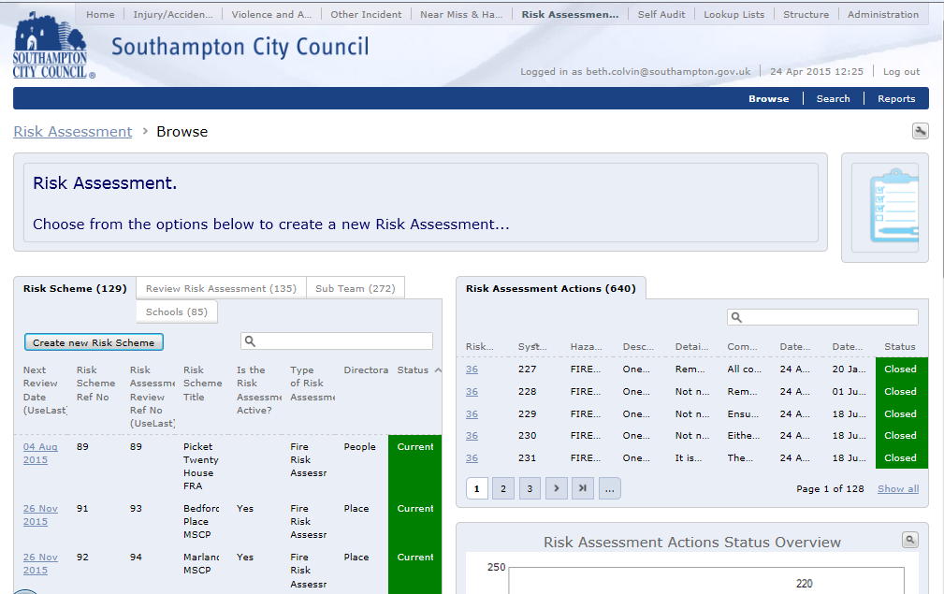
This will then take you to the Risk Assessment page of the database.
To view the details of an FRA click on the “Next Review Date”

Slide 7
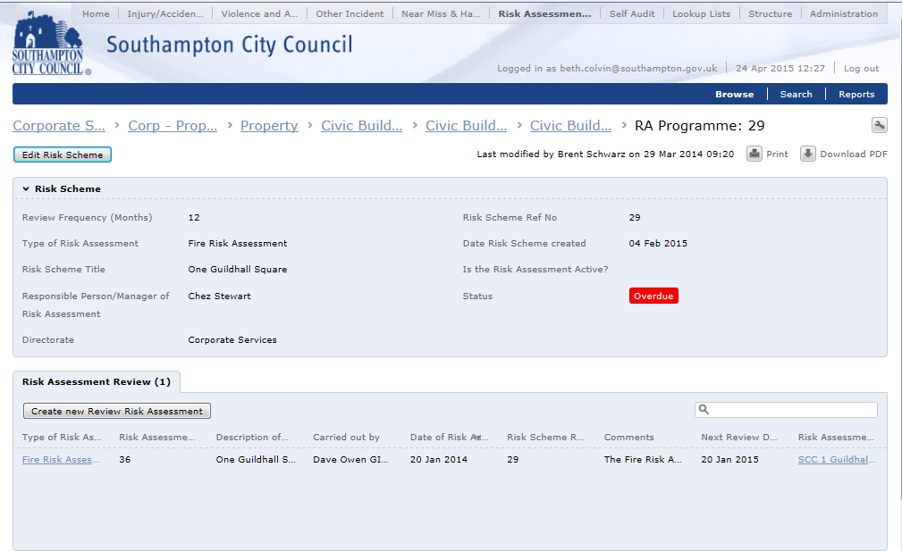
To view your most current FRA and the actions required select the link below:

Slide 8
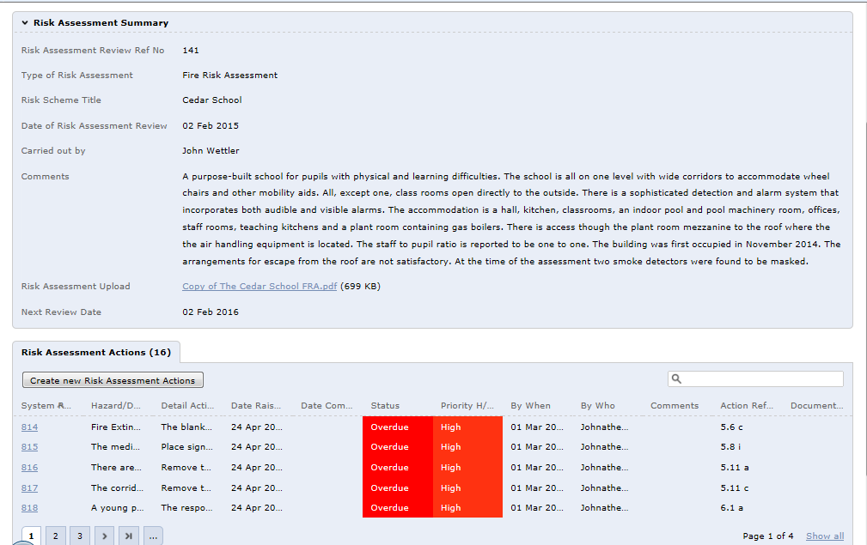
This will then take you to the Risk Assessment Summary and Actions page.
To download a copy of your FRA select the Risk Assessment Upload:
To view a requested action select the action reference number:

Slide 9
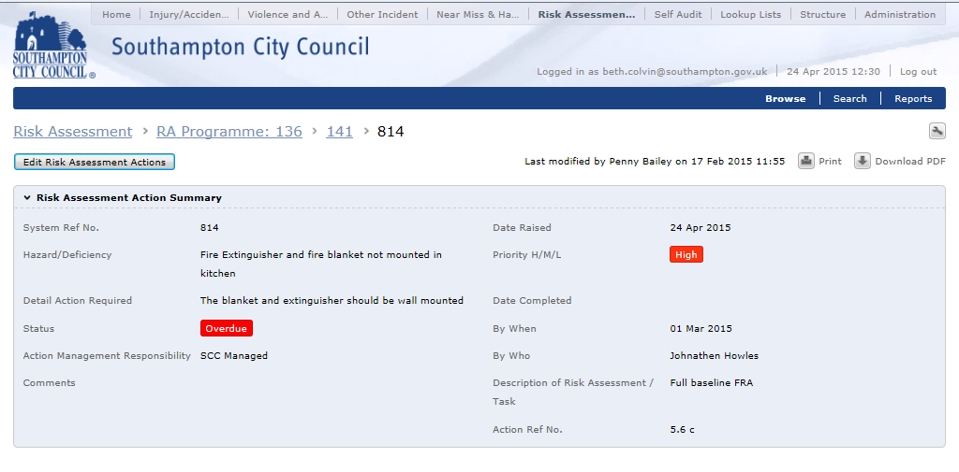
To update the status of the action select “Edit Risk Assessment Actions”:

Slide 10
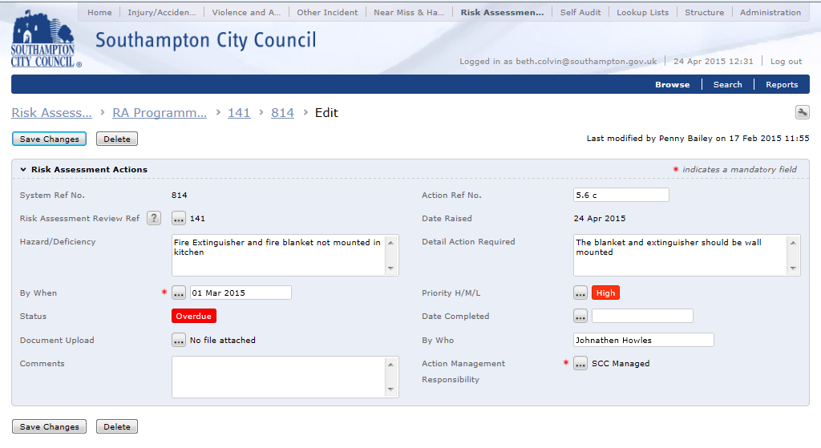
To update the status, complete the “Date completed” section, add any additional comments and select “Save Changes”.

